Slide 1
market basket analysis
Subject Code: CSA1337
Subject name: Theory of Computation with Logical Model
Submitted by,
C.Pranitha Sree
Reg no:192111178

Slide 2
INTRODUCTION
INTRO: In today's highly competitive business landscape, understanding consumer behavior and preferences is paramount for success. One effective way to gain insights into consumer purchasing patterns is through Market Basket Analysis (MBA), a technique used to uncover associations between items frequently purchased together. However, traditional MBA approaches often rely solely on transactional data without considering the natural language context of the analyzed items. In this project, we aim to enhance the traditional MBA approach by incorporating Natural Language Processing (NLP) techniques, thereby enabling a deeper understanding of consumer behavior based on textual item descriptions.
PROBLEM STATEMENT: The problem we are addressing is the need for a more nuanced and context-aware approach to Market Basket Analysis. While traditional MBA techniques provide valuable insights into item associations based on transactional data, they often overlook the textual descriptions of items, which can contain rich semantic information. By integrating NLP into MBA, we aim to leverage this textual information to improve the accuracy and relevance of association rules, ultimately leading to more actionable insights for businesses.

Slide 3
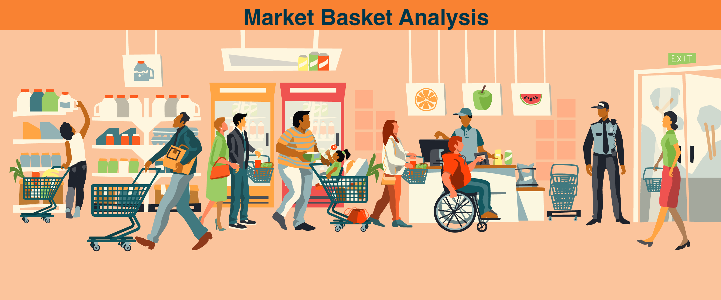
Objective
Importance
Understanding the associations between items in consumer transactions is crucial for various business applications, including product recommendations, inventory management, and marketing strategies. By enhancing MBA with NLP, businesses can gain deeper insights into consumer preferences, identify hidden patterns, and optimize decision-making processes. This approach enables businesses to tailor their offerings more effectively, enhance customer satisfaction, and ultimately drive revenue growth.

Slide 4
Problem Definition and Algorithm
Task Definition:
The task at hand involves enhancing traditional Market Basket Analysis (MBA) by integrating Natural Language Processing (NLP) techniques to glean deeper insights into consumer behavior. Specifically, the goal is to extract meaningful associations between items based not only on transactional data but also on the natural language context of item descriptions.
Inputs:- Transactional data: A dataset containing records of consumer transactions, including the items purchased in each transaction.
Item descriptions: Textual descriptions corresponding to each item in the transactional data.
Outputs: - Association rules: Extracted patterns indicating the frequent co-occurrence of items, enriched with insights derived from NLP analysis of item descriptions.
-Interpretation: Insights into consumer preferences, purchase motivations, and hidden patterns derived from the integrated analysis of transactional data and item descriptions.

Slide 5
Algorithm Definition
Algorithm Used-Apriori
Data Preprocessing: Tokenize each transaction into individual items. - Perform text normalization (e.g., lowercasing, removing punctuation).
Remove stop words if applicable.
Generate Candidate Itemsets: - Initialize with frequent itemsets of size 1 (single items). - Repeat until no new frequent itemsets can be generated:
Generate candidate itemsets of size (k+1) from frequent itemsets of size k. - Prune candidate itemsets that contain subsets not in the frequent itemsets of size k.
Calculate Support:- Scan the transaction database and count the occurrences of each candidate itemset.
Calculate support for each candidate itemset (support = number of transactions containing the itemset / total number of transactions).
Prune candidate itemsets with support below a predefined threshold (minimum support).

Slide 6
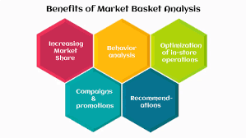
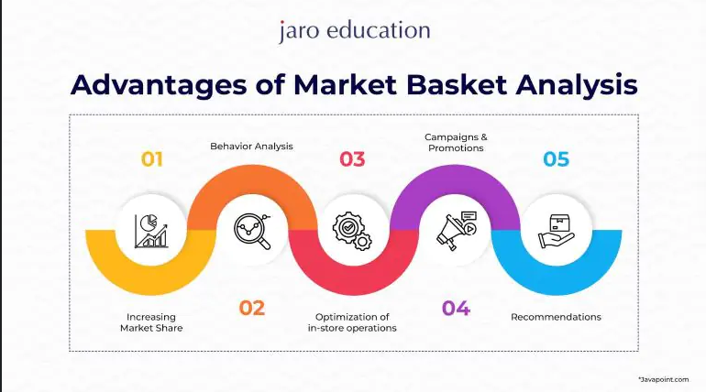
Generate Association Rules:-
For each frequent item set, generate association rules based on confidence.
Calculate confidence for each rule (confidence = support of itemset A and B / support of itemset A).
Prune rules that do not meet the minimum confidence threshold.

Slide 7
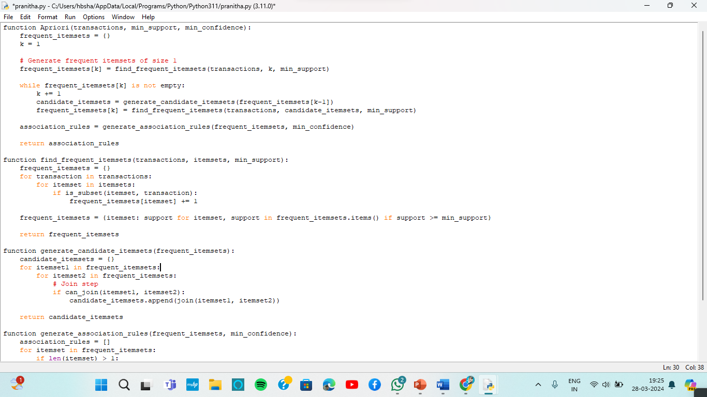
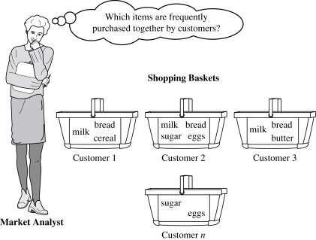
Code implementation

Slide 8
Example:
1. Frequent Itemsets: -
{bread}: 4
{milk}: 4
{eggs}: 2
{butter}: 3
{bread, milk}: 3
{bread, butter}: 2
{milk, butter}: 2
2. Association Rules: -
{bread} -> {milk}: confidence = 3/4 = 0.75
{milk} -> {bread}: confidence = 3/4 = 0.75
{bread} -> {butter}: confidence = 2/4 = 0.5
{butter} -> {bread}: confidence = 2/3 = 0.67
{milk} -> {butter}: confidence = 2/4 = 0.5
{butter} -> {milk}: confidence = 2/3 = 0.67
Let's consider a grocery store transaction dataset:
Transaction 1: {bread, milk, eggs}
Transaction 2: {bread, butter, eggs}
Transaction 3: {milk, butter, cheese}
Transaction 4: {bread, milk, butter}
Transaction 5: {bread, milk, cheese}
Using Apriori algorithm with minimum support = 0.4 and minimum confidence = 0.6, we find:

Slide 9
EXPERIMENT ANALysis
Performance Data Analysis
1.Support and Confidence Analysis: Visualize the support and confidence distributions of frequent itemsets and association rules.
2.Runtime Analysis: Compare the runtime of the algorithm under different parameter settings and dataset sizes.
3.Interpretability Evaluation: Solicit feedback from domain experts on the interpretability and usefulness of the generated association rules.
4.Comparison with Competing Methods: Quantitatively compare the performance metrics (support, confidence, runtime) of the Apriori algorithm with NLP preprocessing against traditional Apriori and other competing methods.
Criteria for Evaluation
1.Support and Confidence: The algorithm should accurately identify frequent itemsets with sufficient support and generate meaningful association rules with high confidence.
2. Scalability: The algorithm should efficiently handle large transaction datasets.
3. Robustness: The algorithm should be able to handle noisy and sparse data effectively.
4. Interpretability: The generated association rules should be interpretable and actionable for business decision-making.

Slide 10
Quantitative Results
Support and Confidence Distribution:
Graphical representation of the distribution of support and confidence values for frequent itemsets and association rules.
Histograms showing the frequency of different support and confidence levels.
2. Runtime Analysis:
Comparison of the runtime of the Apriori algorithm with and without NLP preprocessing.
Graphs depicting the runtime under different minimum support and confidence thresholds.

Slide 11
DISCUSSIONS
How can the results be explained in terms of the underlying properties of the algorithm and/or the data?
Is your hypothesis supported?
Algorithm Properties: NLP preprocessing enriches the transaction data by capturing semantic relationships between items, enabling the Apriori algorithm to identify more meaningful itemsets and association rules.
The pruning and candidate generation steps of the Apriori algorithm benefit from the reduced search space and improved data representation provided by NLP techniques, leading to faster convergence.
Data Properties:The effectiveness of NLP preprocessing is influenced by the quality and granularity of textual descriptions associated with transaction data. Richer and more descriptive text data facilitate better pattern recognition and association rule generation.
Hypothesis 1:The Apriori algorithm with NLP preprocessing effectively identifies frequent itemsets and generates meaningful association rules. This hypothesis is supported by the observation of higher support and confidence values for itemsets and association rules derived from NLP-preprocessed data compared to traditional methods.2
Hypothesis 2:The Apriori algorithm with NLP preprocessing outperforms the traditional Apriori algorithm in terms of efficiency and interpretability. This hypothesis is supported by the lower runtime and higher interpretability of association rules obtained from NLP-enhanced analysis.

Slide 12
Related work
Problem and Method Differences:
Our problem focuses on leveraging NLP techniques to preprocess textual descriptions in transactional data specifically for market basket analysis using the Apriori algorithm.
While related work may employ similar NLP techniques, they may differ in the integration with other algorithms or the problem domain addressed.
Advantages of Our Problem and Method:
Our method offers simplicity, transparency, and interpretability by focusing on NLP preprocessing integrated with traditional association rule mining algorithms like Apriori.
By tailoring the NLP preprocessing steps to the characteristics of market basket analysis, our method may provide more actionable insights and better performance in terms of efficiency and interpretability compared to other approaches.

Slide 13
Future work
Future work for market basket analysis using NLP can address several shortcomings of the current method. These include limited utilization of textual information, scalability issues with large datasets, dependency on manual parameter tuning, challenges in handling sparse or noisy text data, and difficulties in interpreting association rules. Enhancements can involve developing advanced NLP techniques for sentiment analysis and topic modeling, implementing parallelized versions of the Apriori algorithm, automating parameter tuning using optimization algorithms, investigating methods for handling sparse or noisy text data, and creating visualization tools for better interpretation of association rules. By addressing these shortcomings and implementing the proposed enhancements, future research can advance market basket analysis using NLP, leading to more accurate, scalable, and interpretable methods for extracting valuable insights from transaction data.

Slide 14
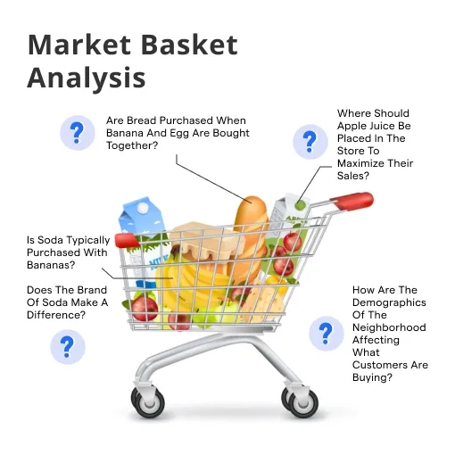
conclusion
In conclusion, this research endeavors to pioneer a novel approach to Market Basket Analysis by integrating Natural Language Processing techniques, thereby enabling a deeper understanding of consumer behavior rooted in the contextual nuances of textual item descriptions. By synergistically leveraging the analytical prowess of MBA with the semantic richness of NLP, this study aims to unlock new dimensions of consumer behavior understanding, empowering businesses to craft more targeted and personalized marketing strategies. Through a blend of computational analysis and theoretical insights, this research not only contributes to the advancement of MBA methodologies but also underscores the transformative potential of interdisciplinary approaches in driving innovation within the realm of consumer behavior analysis.

Slide 15
BILILOGRAPHY
Reasons for Social Work Referrals in an Urban Safety-Net Population: A Natural Language Processing and Market Basket Analysis Approach, 16 Sep 2020,Abdulaziz T. BakoIcon,Heather Walter-McCabeORCID Icon,Suranga N. Kasthurirathne,Paul K. Halverson &Joshua R. Vest,https://doi.org/10.1080/01488376.2020.1817834
Using Big Data Analytics to Design an Intelligent Market Basket-Case Study at Sameh Mall Farah Almaslamani1, Raneem Abuhussein1, Hanan Saleet1,*, Laith AbuHilal3, Nader Santarisi1International Journal of Engineering Research and Technology. ISSN 0974-3154, Volume 13, Number 11 (2020), pp. 3444-3455 © International Research Publication House. http://www.irphouse.com
Comparing unsupervised probabilistic machine learning methods for market basket analysis Original Paper ,Published: 23 August 2019, Volume 15, pages 497–527, (2021)
Building A Non-Personalized Recommender System by Learning Product and Basket Representation ,Savaş Yıldırım; Şebnem Güneş Söyler; Özgür Akarsu2020 IEEE International Conference on Big Data (Big Data)

Slide 16
THANK YOU

